Slide 1
Implementation of LIST using LINKED LIST
DSA LAB 1

Slide 2
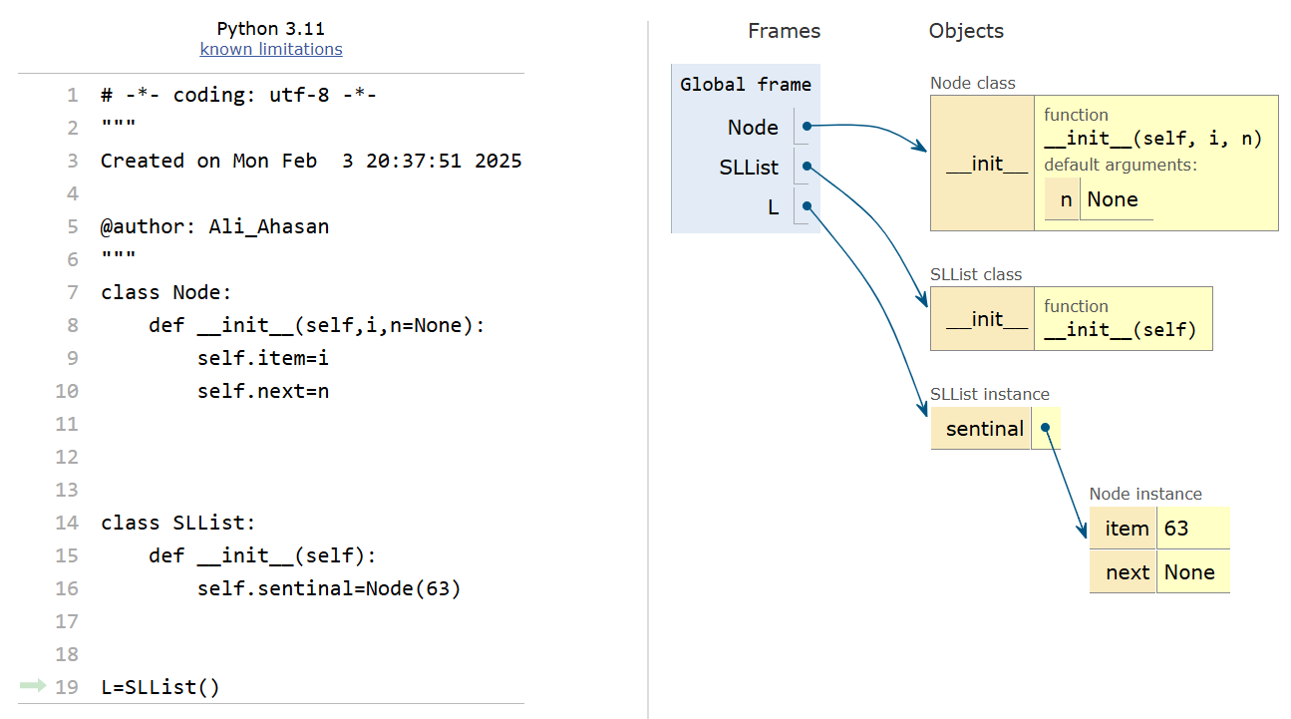
Empty Linked List
Python Tutor

Slide 3
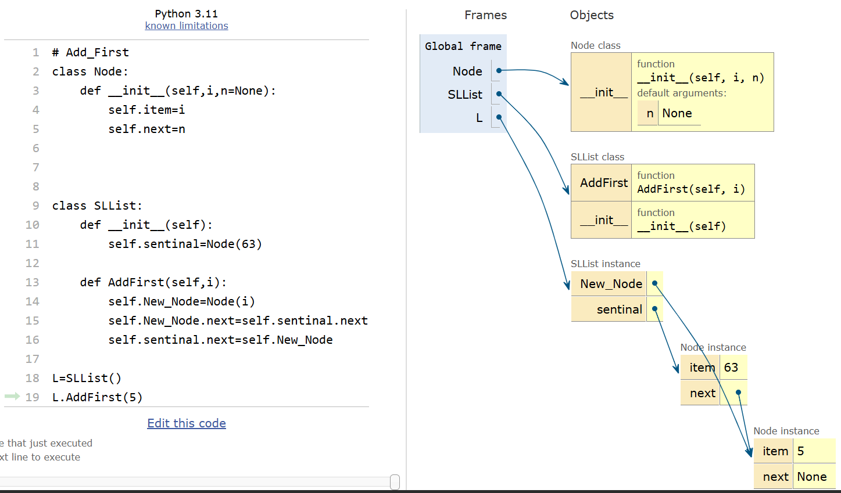
The AddFirst Method

Slide 4
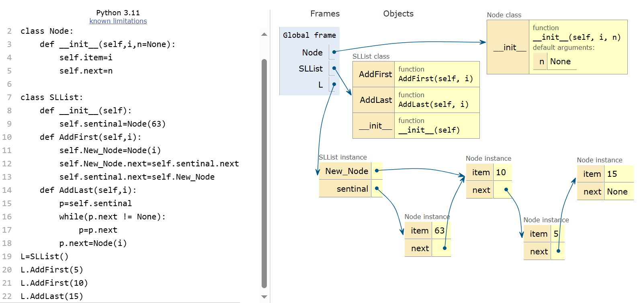
The AddLast Method

Slide 5
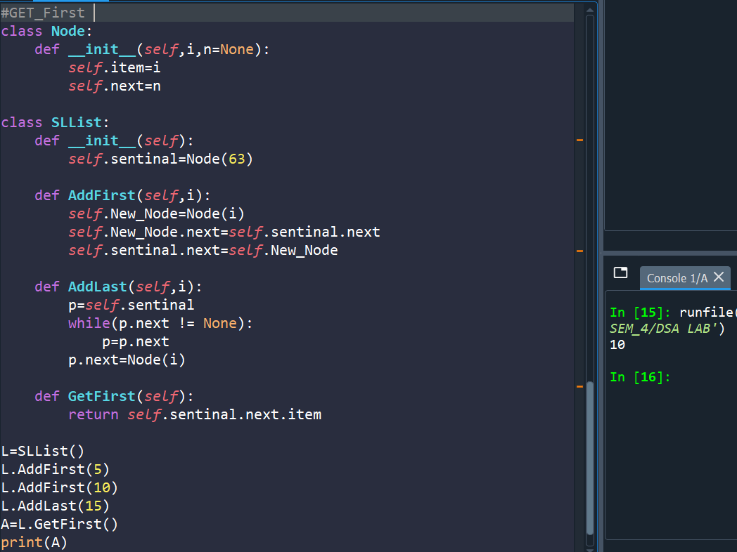
The GetFirst Method

Slide 6
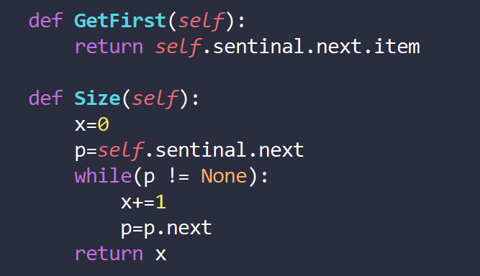
The Size Method

